Slide 1
Divided Kingdom II
Lesson #3
Amos
Sunday May 12, 2024

Slide 2
Divided Kingdom
Judah
Rehoboam
Abijah
Asa
Jehoshaphat
Jehoram
Ahaziah
Athaliah
Joash
Amaziah
Uzziah
Israel
Jeroboam
Nadab
Baasha
Elah
Zimri
Omri
Ahab
Ahaziah
Jehoram
Jehu
Jehoahaz
Joash
Jereboam II
Amos ~760-755 BC
Notes:
35-40 years prior to the Fall of Israel/Samaria (722 BC); Amos lived during the days when the reign of Jeroboam II in the north overlapped with the reign of Uzziah in the south.

Slide 3
Amos the Shepherd Becomes a Prophet
Amos derived from Hebrew; the root “amas”
means “to lift a burden, to carry”
“Burden-Bearer”
A native of Tekoa (near Jerusalem); a city built on a hill overlooking the wilderness of Judah, one of the most desolate areas in Canaan.

Slide 4
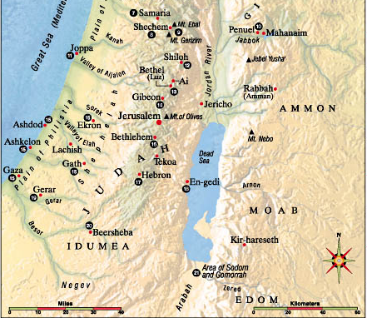
Tekoa
6 miles south of Bethlehem
12 miles south of Jerusalem
about 18 miles west of the Dead Sea

Slide 5
Amos the Shepherd Becomes a Prophet
Amos 1:1; 7:14 Occupation until called to be a prophet
Bearer of Burdens
Made a Prophet by God (didn’t choose to be a prophet)
Shepherd
Grower of Sycamore Fruit
Common Man With Authoritative Message (Lives out in the Country)
Notes:
Amos 7:14 New American Standard Bible (NASB)
¹⁴ Then Amos replied to Amaziah, “I am not a prophet, nor am I the son of a prophet; for I am a herdsman and a ^{[a]}grower of sycamore figs. ; God made him a prophet none the less
Sycamore fruit A fig-like fruit, slightly sweet & watery. Somewhat woody in nature.
A gatherer. Perhaps, ‘scraper:’ alluding to the practice of scraping or making incisions in the sycamore fruit, to promote its maturity. As this fruit was common and bland, and was eaten chiefly by the poor, it is likely that Amos was a poor man.
Earthquake doesn’t help with an exact date because we have no historical account of the event but it is referenced some 300 years later by Zechariah the prophet in Zch 14:5).

Slide 6
Moral, Political, Religious & Social Climate in Israel During This Time
Due to a 60-year respite from the east (Assyria), Judah and Israel had enlarged & strengthened their borders. (It was also during this time that Jonah visited Nineveh).
Through trade, agriculture, and conquest Israel was able to bring great prosperity to the people.
The leadership in Assyria changed and the monarch immediately set out on a conquest that would include the west (Israel).
It was during this time of prosperity and wealth, prior to the new monarch in Assyria, that Amos was called to prophesy to the nation.

Slide 7
Moral, Political, Religious & Social Climate in Israel During This Time
The luxury (selfishness) of the nation is clearly seen in the prophet's comments (3:12 ; 3:15 ; 6:3-6)
Moral & Political corruption: the treatment of the poor (5:11-12) ; the general contempt for things holy (2:6-8); disorder, oppression, violence & robbery (3:9-10)
Religious corruption: they were showing outward “worship” but it was not acceptable to God (4:4-5); Religious fervor was high, but true spiritual devotion to God was not happening (8:5-6)

Slide 8
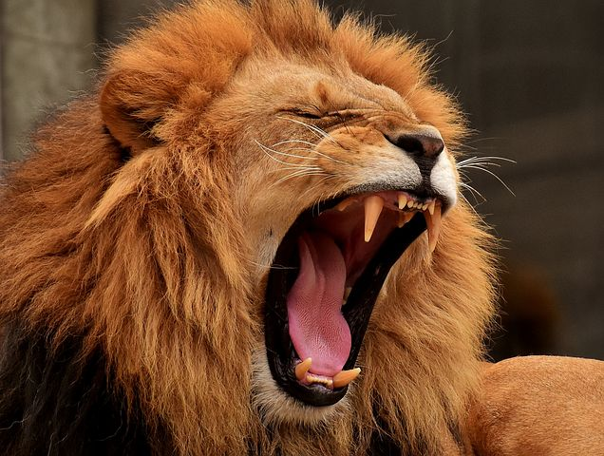
The Message: Judgement & Doom is Coming
And he said: "The LORD roars from Zion, And utters His voice from Jerusalem; The pastures of the shepherds mourn, And the top of Carmel withers.“ (1:2)
For all their corruption, God would bring them into judgment, therefore “prepare to meet thy God, O Israel” (4:12)
Notes:
We live in a society where we water down, humanize, tame, weaken, etc… God
The prophet says “the LORD ROARS!” We better Sit up and take notice like the lion is coming for us!
Mount Carmel in the North is normally lush but it is about to wither away!

Slide 9
Amos Outline
Outline
The Approaching Judgement on all nations (Ch. 1-2)
God’s Basis for Judgement on Israel (Ch. 3-6)
Judgement is Inevitable/ Five Visions of Amos (Ch.7-9)
  There will be NO escape

Slide 10
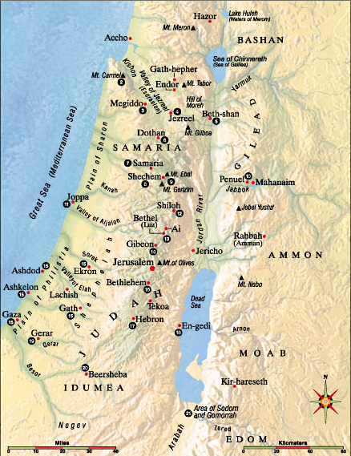
God’s punishment of the nations
(as identified by Amos)
Tyre
Damascus
Israel
Ammon
Judah
Gaza
Moab
Edom

Slide 11
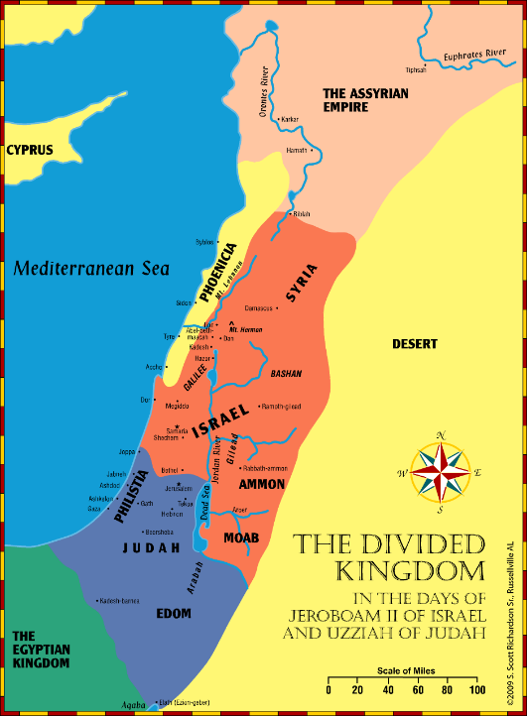
Amos (Chapters 1-2): Judgements on Border Nations
For the three transgressions of _________ and for four
What does this mean?
This group of nations is judged for mistreating others (barbaric, no compassion)
Damascus | Gaza | Tyre
Notes:
Three transgression and four – This isn’t a mistake, this is 1. wickedness, 2. upon wickedness, 3. upon wickedness, and 4. MORE); Continued Wickedness
Your nations wickedness is full
I am done with it!
1:3-5 (Damascus)
1:6-8 Gaza (Philistia)
1:9-10 Tyre (Phoenicia)

Slide 12
Amos (Chapters 1-2): Judgements on Border Nations
For the three transgressions of _________ and for four
This group of nations is judged for mistreating brethren/family
Amos 1:13
Edom | Ammon | Moab
Notes:
The next set (Edom, Amon and Moab)
Family (pursued his brother)
Judged
Read 1:13
How do we treat family sometimes?
1:11-12 Edom
1:13-15 Ammon
2:1-3 Moab

Slide 13
Amos (Chapters 1-2): Judgements on Judah and Israel
Reminds them of what He has done for them
Highlights how they treated the poor
  See 2:6-7
I gave you Nazarites
  You gave them wine
I gave you prophets
  You told them, “Do not Prophesy!”
See God’s despair (2:13)
For the three transgressions of _________ and for four
Judah and Israel are being judged for mistreating the LORD
Judah | Israel
Notes:
Now we turn to Judah and Israel
Instead of what they have done to others, it turns to what they did to God
Reminds them of what he has done for them
Highlights how they have treaded the poor (Read 2:6-7)
I gave you Nazarites and you gave them wine to drink
I gave you Prophets and you told them “Do n
ot prophecy!”
Read 2:13 and see God’s despair.
Judah 2:4-5 Not keeping the commandments
Israel 2:6-16 Not keeping the commandments

Slide 14
Chapters 3-6 “Why Judgement on Israel?”
Am 3:1-2 ¶ Hear this word that the LORD has spoken against you, O children of Israel, against the whole family which I brought up from the land of Egypt, saying: You only have I known of all the families of the earth; Therefore I will punish you for all your iniquities."
Notes:
3:1-2 – Message is to the 12 tribes (Judah and Israel). They had a special relationship with God that no other nation had. They knew exactly how to please God, yet they turned their backs on Him. Therefore, they are held to a higher standard (v2).

Slide 15
Chapters 3-6 “Why Judgement on Israel?”
Series of questions with obvious answers (3:3-8)
  Ends with when judgement comes, it was God who brought it
Call Ashdod (Philistines) and Egypt to come and see
  Show them that Israel is just as evil as the other nations (3:10)
As a shepherd takes from the mouth of a lion Two legs or a piece of an ear, So shall the children of Israel be devoured… (3:12)
Notes:
3:3-8 - A series of questions with obvious answers ending with a warning that when judgement comes it is God who is doing it but he will tell it through a prophet first (v.8). When the Lord speaks, people should listen.
3:9-11 – Call those from Ashdod (Philistines) and Egypt, telling them to come and see. What are they to see, that Israel is as bad as all the other nations (v. 10)
3:12-15 – The judgement that is to come.
They will be like the two legs and a piece of the ear that the shepherd rescues from the lion’s mouth v. 12.

Slide 16
You Cows of Bashan: Selfish Wives of Samaria
Judgement against their Luxuries (3:15-4:1)
He will take you away with fishhooks (4:2)
Notes:
Judgment against their luxury – HOLD on to this thought-Do we live selfishly not giving back to others?
Do you think Amos is passionate about this topic as you think about his background? He is a common man, a shepherd, poor
You cows (Kine) of Bashan
Bashan.—This contained the rich pasture-lands east of the Jordan, between Hermon and the mountains of Gilead, where cattle flourished. The “strong bulls of Bashan” (Psalm 22:12) were descriptive of the malignant enemies of the ideal sufferer. The feminine “kine” (cow) refers to the luxurious self-indulgent women of fashion in Samaria

Slide 17
Yet, you have not returned to Me!
No matter what God did to discipline Israel- they remained corrupt (4:6-11)
Famine
Drought
Blight, Mildew and Locust
Plagues
Sodom and Gomorrah
THEREFORE, PREPARE TO MEET YOUR GOD!
Notes:
Chp 4 - Yet you have not returned to me (This phrase repeats throughout chp 4)
Famine (cleanness of teeth and lack of bread) v. 6
Drought (rain on one farm but not the other) v 7-8
Blight, Mildew, and locust (vineyards, fig trees, olives) v. 9
Plagues (v. 10)
Destroyed like Sodom and Gomorrah v. 11
I brought these things against you to discipline you so that you would seek Me, Yet you have not returned to me ! You stubborn people refuse to learn and submit to My will!
THEREFORE, PREPARE TO MEET YOUR GOD!

Slide 18
Chapters 5 “Why Judgement on Israel?”
}
How does this sound?
1,000 will go out and 100 will come back
100 will go out and 10 will come back (5:3)
Repent (5:4, 6, and 14)
  Seek Me and Live
  Seek God and Live
  Seek Good and not Evil
Notes:
1000 will go out but 100 will come back or 100 will go out and 10 will come back. How does that sound?
Repent – “Seek Me and live”, “Seek God and Live”, “Seek Good and not Evil” (v. 4, 6, and 14)
Don’t seek Bethel
Don’t seek Gilgal
Don’t go over too Beersheba
They will come to nothing

Slide 19
Chapters 5 “Why Judgement on Israel?”
God reminds them who He is (5:8-9)
  THE LORD (ALL Powerful, All Knowing, & ALL Present)
God reminds them who they are- corrupt! (5:10-11)
God reminds them who they should be: Hate Evil, Love Good, Establish Justice (5:15)
It may be that the Lord God will be gracious to the few that repent (5:15)
Notes:
He reminds them who He is v. 8
He reminds them who they have been v. 10-11
Hate evil, love good, establish justice,
It may be that the Lord God of host will be gracious (v. 15)
Just like the people of Assyria said when Jonah pronounced Judgement -but God’s people don’t repent
Since they will not repent, Judgement
Read v. 19
Rebukes them for their ritual worship
But let justice run down like water and righteousness like a mighty stream (v. 24)
They will be taken captive beyond Damascus v. 27

Slide 20
Chapters 6 “Why Judgement on Israel?”
Their worship had become vain (worthless) (5:21-23)
Their trust had become in themselves and their possessions
“Have we not taken Karnaim for ourselves, by our own strength?” (6:13); city on the far eastern border across the Jordan
They had become so arrogant in their own strength they gave God no credit for their success; therefore, captivity is coming soon (6:7; 7:11,17; 9:8)
Notes:
Chapter 6
They worship had become vain and ritualistic (chp 5) and their trust is in themselves and their possessions?
Note the success God has given them at this time?
What has this become for them?
What is the lesson here?
Have we taken Lo Debar “by our own strength”? v. 13.
Yes this is where they are at.
And this is the reason for their Judgement.

Slide 21
Chapters 7-9: 5 Visions of Judgement
Locust Swarm (7:1-3); God relents
Great Consuming Fire (7:4-6); God relents
A Plumb Line (7:7-9); if Israel were a wall, they would be crooked ;they are about to have a great fall
Summer Fruits (8:1-14); the harvest is approaching, and God is about to uproot Israel!
The Lord Strikes the Pillars of the temple (9:1-10); there is nowhere to run; all sinners will be slain
Notes:
Chapter 7-9 Visions of Judgment
Locust swarm (7:1-3)
Amos pleads
God relents
Great consuming fire (7:4-6)
Amos pleads
God relents
A Plumb Line (7:7-9)
What is the purpose of a plumb line? He is measuring (their works) up.
God does not relent, “I will not pass by them anymore”
Summer Fruit (8:1-14)
Amos, what do you see?
I see a basket of summer fruit
God does not relent, “I will not pass by them anymore.
Judgement
If time allows v. 4-6, describes their current state of depravity
Followed by Judgement
Note the famine from the word of the Lord v. 11-`12
The Lord strikes the pillars of the temple and breaks them into pieces (9:1-10)
He who flees will not get away. There is nowhere you can hide from God (v. 1-4).
All the sinners of My people shall die by the sword v. 10.

Slide 22
Two Interludes (breaks in the prophecy)
Amaziah the priest of Bethel, Jereboam, Amos, & God
Amos 7:10-17
A Messianic Message of Hope
Amos 9:11-15
Notes:
Two interludes (breaks from Amos’ prophecy against Israel) in the last section
Amos’ Message and Work (7:10-17)
Amaziah the priest of Bethel sent to Jeroboam king of Israel to tell on Amos.
Amos has conspired against you
The land is not able to bear all his words
‘Jeroboam shall die by the sword, and Israel shall surely be led away captive’
Amaziah said to Amos
Go you seer!
Flee to the land of Judah
Never prophesy again at Bethel (King’s sanctuary/royal residence)
Amos answers:
Read 14-15
You says, “do not prophecy against Israel.
God says,
“Your wife shall be a harlot”
Your sons and daughters shall fall by the sword
The land shall be divided
You shall die
Israel shall be led away captive
God ends with a message of Hope and a Messianic Message (9:11-15)
After the revelation of the famine of the words of God, “on that day, I will raise up the tabernacle of David”. How would this sound to the people?
It has fallen down.
I will repair its damages
I will raise up its ruins
Rebuild it as in the days of old.
When it is rebuilt, it will contain all nations (Edom and Gentiles “called by My name”.
I will bring back the captives of My people Israel
I will bless them.

Slide 23
Lessons
Blessings for obedience , Discipline for disobedience (2 Chronicles 26:4-5)
God even tries to convince Israel (like Assyria) they could be blessed if they would repent (2 Kings 14:5)
God can use a low and common man to deliver an extraordinary message (shepherd, no formal education, farm labor)
Notes:
1- We can be filled with blessings if we choose God’s way
2- We can escape wrath if we will repent and turn to God
3- God can use any of us to deliver His message of hope

Slide 24
Lessons
The LORD Roars!
  We need to stop trying to “water-God-down”!
God will judge all nations based on their deeds
  For the three transgressions of __________ and for four.
God will hold us accountable to how we treat those less fortunate.
Notes:
4- God is all powerful; respect that and teach that; He is over all creation and can overcome anything
5- God will judge all nations; No nation is getting away with their deeds
6- We must be compassionate to the less fortunate especially those who love God; Share your wealth

Slide 25
Lessons
What can we learn from the following two statements
  I gave you Nazarites and you gave them wine to drink
  I gave you prophets and you told them “do not prophesy!”
We need to see God’s despair in 2:13
Notes:
7- God does not appreciate our interfering with his laws with our opinions; Don’t worry about this or that, God loves you anyway, etc…
8-God shows great sadness when we turn away from His love

Slide 26
Lessons
We (God’s special people) need to take heed of Israel’s (God’s special people) example and not turn away from God
Our sins separate us from God just like theirs did
-we must flee from them and turn to God
Seek God to overcome trials-Don’t give up!

Slide 27
Lessons
Don’t go through the motions or practice our own form of worship-God won’t accept it
Give God the Credit for our successes (Humility)
God’s Patience has a limit (Longsuffering but Just)
We must stand up for God even when others try to squelch our faith (Amos versus Amaziah)

